Slide 1
EVALUATION SUCCESS STATEMENT FOR OUR SYSTEM
The overall evaluation design comprises of following phases:
Evaluating the product.
TrailSeek comparison with other similar products.
Technology Choices and their evaluation.
Analysing the results.
Success rate vs Error rate matrices.
User Impact on various performed tasks.
Success rate of TrailSeek.

Slide 2
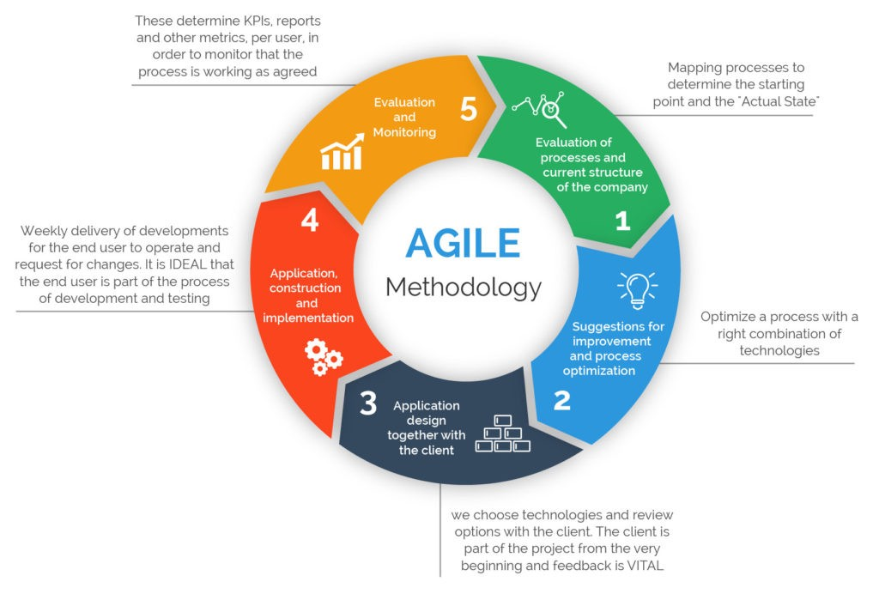
CONCLUSION PROJECT MANAGEMENT STRATEGY FOR
CHALLENGES, LEARNING OUTCOME
AND FOLLOWING COMPLEXITIES
Technology
Project Management
Testing
Data
Distributed Development
1. Sprint Planning.
2. Daily Stand-up meeting
3. Sprint Review:
4. Sprint Retrospective

Slide 3
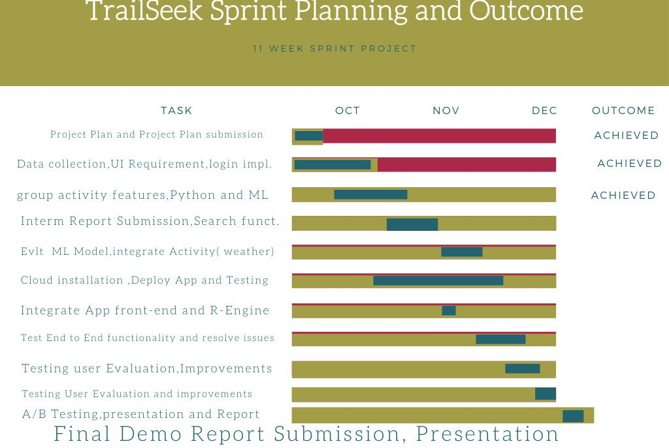
Project Milestones

